Slide 1
L04 – Requirements
FIT2101: Software Engineering Process and Management
S2 2018

Slide 2
In this lecture…
Requirements in Agile projects
User stories

Slide 3
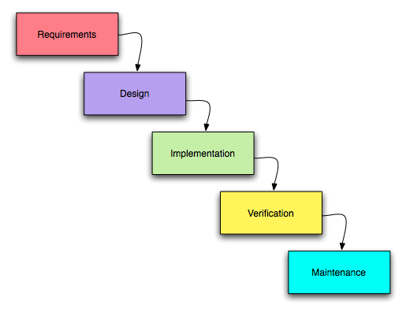
What are requirements?
In traditional SE, they’re the thing you worry about first
what are we supposed to build?

Slide 4
What are requirements?
Requirements are what determine whether your software is
complete
correct
Requirements are usually determined by the Product Owner, but other stakeholders might have some input as well
the Tax Office determines whether your GST or payroll tax computations are correct, not only your client
remember that the team advises the Product Owner
team can come up with some of the requirements too!
Because requirements tell you what behaviour is considered correct, they’re hugely important to testing
every requirement should be tested
each test should be able to be traced back to corresponding requirements

Slide 5
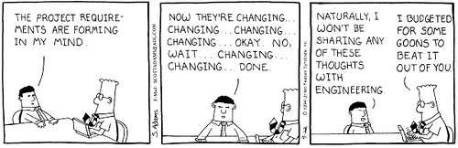
Getting requirements out of clients
In Waterfall models, requirements are elicited once, at the start of the project, usually by a team of business analysts
Agile processes place more emphasis on a continuing relationship with the client or their representative, but there still needs to be a requirements brainstorming session during project inception

Slide 6
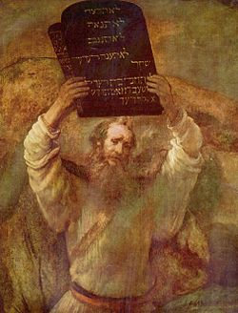
Requirements in traditional process models
Traditional models: text-based
all of the requirements must be written down
the written description must contain all the information necessary to begin to design and implement
typically completed before design begins

Slide 7
Agile approach to requirements
Idea: can be very hard to nail down a complete set of requirements in advance, so don’t try to do that
Instead, get the client (Product Owner) involved in development
get something up and running as quickly as possible
get Product Owner to pick which features to add next, based on client priorities
try to add as much value as possible per iteration
repeat for each sprint
Can’t avoid doing some requirements management during inception – otherwise you won’t have anything to do during your first iteration

Slide 8
Agile approach to requirements
Remember: prefer collaboration over exhaustive documentation
Remember that there is a customer representative on site with the developers: the Product Owner
so no need to write everything down in great detail
Agile requirements documents are prompts or reminders about conversations with the Product Owner

Slide 9
Agile requirements: user stories
A user story is a short description of something that a user would want to do with the system
each story describes a feature that adds value
Agile “requirements documents” are essentially collections of user stories
This approach came out of Kent Beck’s early work on eXtreme programming

Slide 10
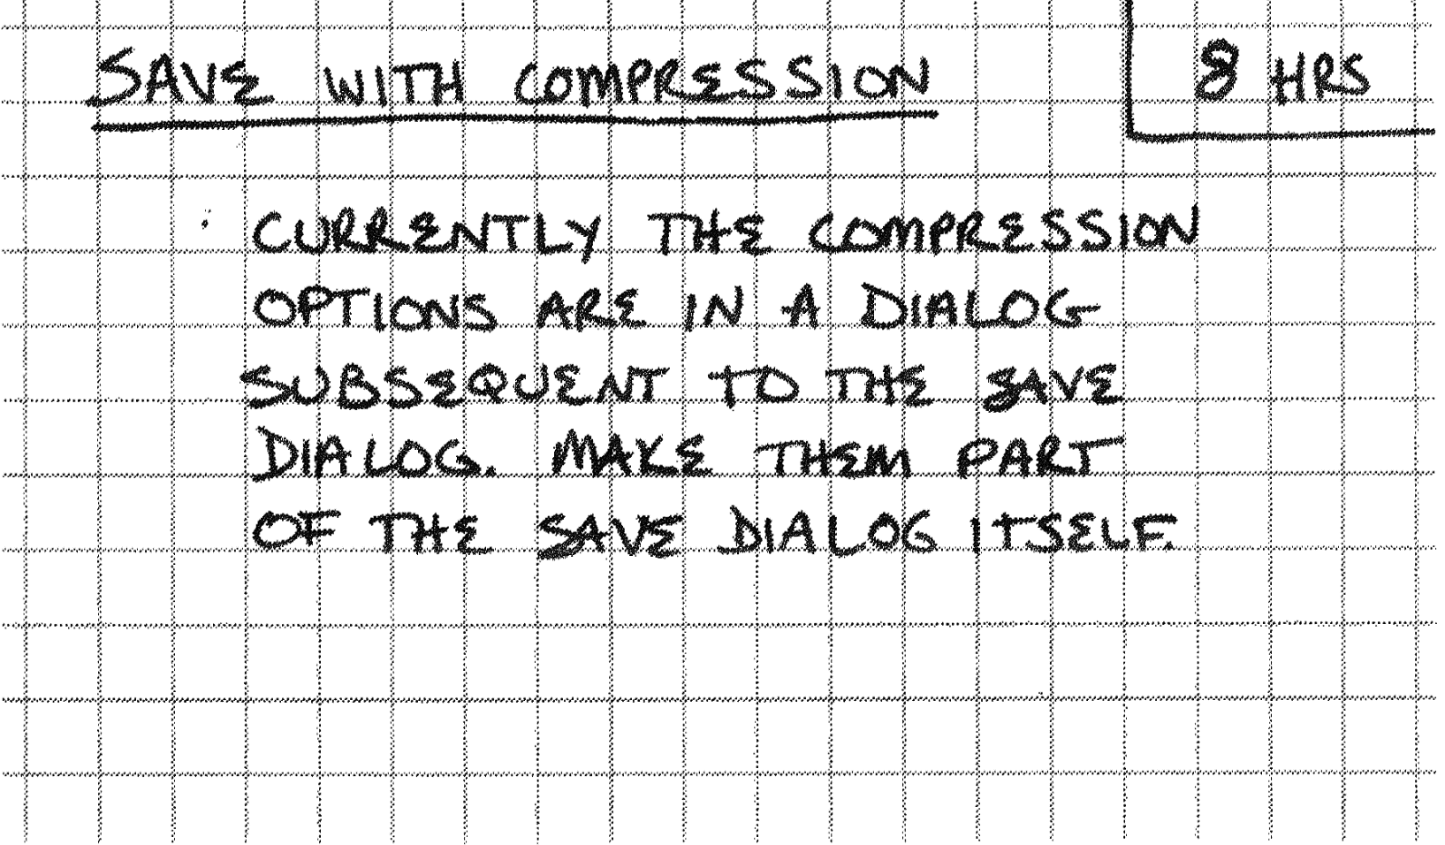
User stories in XP
Notes:
These are examples of Kent Beck’s user story index cards.

Slide 11
User stories in XP
Title
Notes:
Stories need to be uniquely identifiable so that you can talk about them

Slide 12
User stories in XP
Customer-visible functionality
(not design!)
Notes:
Don’t go into how this should be achieved. User stories are requirements, not designs; stick to the what and not the how.

Slide 13
User stories in XP
Effort estimate

Slide 14
User stories in Scrum
Usual template: As a <role>, I want to <goal>
optionally: so that <reason>
Example: As a system administrator, I want to reset a user’s password so that they can log in
Some teams store their user stories on index cards or Post-It notes
then use a whiteboard or kanban for day-to-day task management

Slide 15
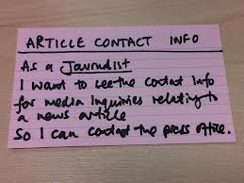
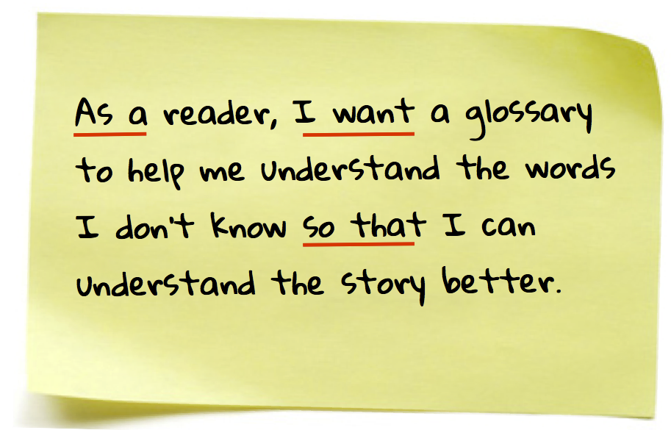
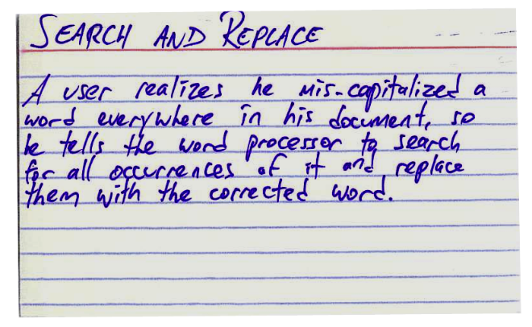
Example user stories
Many different formats possible
basic idea is to capture user requirements as succinctly as possible
If using index cards, can put acceptance criteria on the back
how will we know that the requirement has been fulfilled?
tells you how to test

Slide 16
Acceptance criteria
As well as classifying and prioritizing user stories, the Product Owner also needs to define acceptance criteria
what does the product need to be able to do to make the Product Owner happy?
If short, can write this on the back of a story card
If longer, put on the internet, put the URL on the story card
this is good to do with UI mockups, etc.

Slide 17
Definition of Done
What about general requirements for testing and QA?
e.g. code review requirements, unit test coverage, etc.
don’t want to have to write the same set of QA processes on every single card…
Think about your own programming practices
Do you assume your code is “done” once you’ve finished typing it in?
…once you’ve hit the Save button?
…when it’s compiled?
…when it’s been run at least once?
Each project needs a Definition of Done
what has to happen before a feature is considered complete and ready to roll out?
usually includes code reviews, unit test coverage, running acceptance tests
You only need to document QA processes that aren’t covered by the Definition of Done

Slide 18
Good user stories: INVEST
Good user stories are…
independent: they are self-contained and can stand alone
negotiable: they are easy to change, discard, or replace
valuable: they describe something the end user cares about
estimable: should be sufficiently well-understood/well-defined that the team can estimate how long they will take to implement
small: should be small enough to be able to be confident about estimates
testable: need to be able to be sure when the story has been implemented

Slide 19
Independent
User stories shouldn’t depend closely on other user stories
Need to be able to move them around
in backlog or on a kanban
between releases during release planning

Slide 20
Negotiable
User stories can always be modified, extended, or deleted
as the team and the Product Owner learn more about the project
as the external constraints and internal priorities change
we try very hard not to do this for stories that are part of the sprint backlog!

Slide 21
Valuable
User stories describe functionality that adds value for the customer
Product Owner and team use customer value to decide which stories to put into the sprint backlog during sprint planning

Slide 22
Estimable
We need to be able to estimate how much effort each story will require
so they need to be small enough for this to work
and they need to be well-understood
This estimate of effort will determine how many stories the team will put into the sprint backlog during sprint planning
Big fuzzy stories can still go into the product backlog, but should be refined before they are selected for implementation in a sprint

Slide 23
Small
User stories shouldn’t be too large
it will be hard to fit them into a sprint
it will be hard to estimate them accurately
Rule of thumb: a single story shouldn’t take more than 50% of the effort on a sprint
If your story is too big, consider breaking it down
we will talk about epics and story mapping next lecture

Slide 24
Testable
If you can’t test your story, how will you know when it’s done?
If you don’t know enough about the story to be able to test it, it will need to be refined before you can select it for implementation in a sprint
This is especially important if your team is practising TDD (test-driven development)!

Slide 25
What about other tasks?
Not all the things we want to do on a project involve adding user value
Example: if we add lots of features in a hurry, the design of the system can degrade
When we trade off design quality for a fast implementation, we accrue technical debt
becomes hard to add new features
makes our estimates inaccurate
Like financial debt, technical debt lets us get things done right now
it’s not evil any more than a mortgage is evil
but it will need to be paid off later
pay off technical debt by refactoring (fixing the design)
But refactoring leaves functionality the same: doesn’t add value

Slide 26
Technical user stories
Can keep track of internal-facing tasks separately, don’t hassle the Product Owner about them
but then how do you schedule them into sprints?
Another option: use tech stories
also called developer stories – can cover a lot of situations other than a need to refactor
e.g. As a developer, I want to tidy up the Customer inheritance hierarchy so that I can add new features more quickly
If the Product Owner is pushing for fast delivery that accrues technical debt, they need to accept that this means they’ll have to pay it off by selecting some developer stories at some stage in order to maintain the team’s productivity.
Generic term for things that go in backlog (including user stories, tech stories, spike stories, etc.): product backlog item or PBI

Slide 27
Summary
Requirements
traditional software engineering
Agile software engineering
User stories
INVEST criteria
Definition of Done
PBIs

